Slide 1


Predictable Self-Organization with Computational Fields
Jacob Beal, Mirko Viroli
Tutorial at 8th IEEE SASO
Imperial College London
September 2014

Slide 2
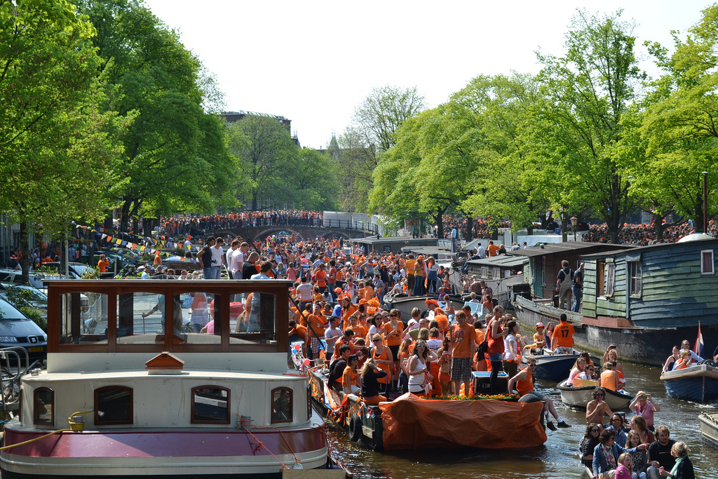
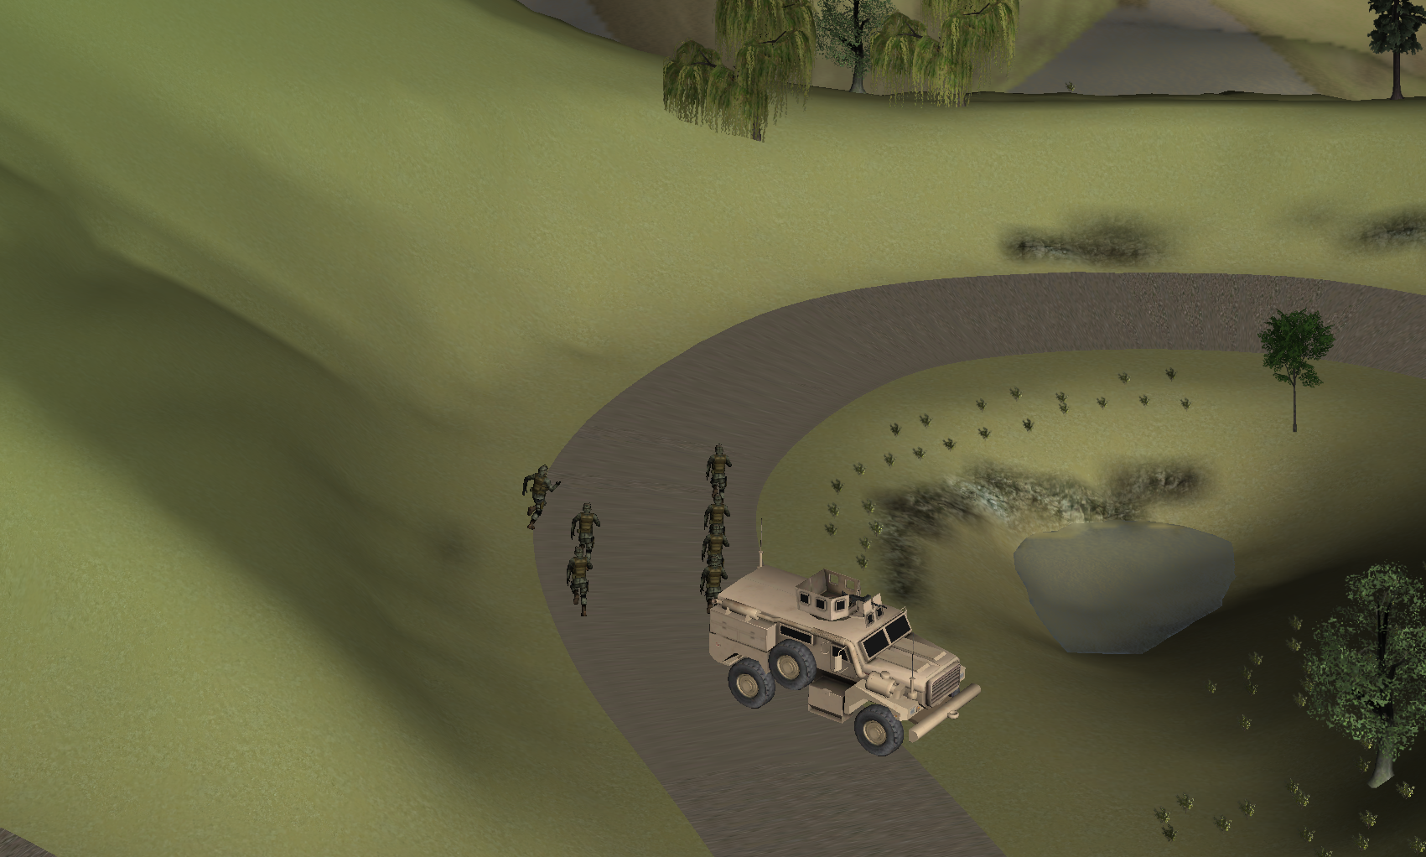
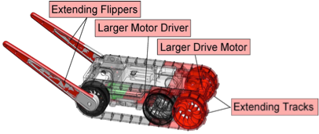
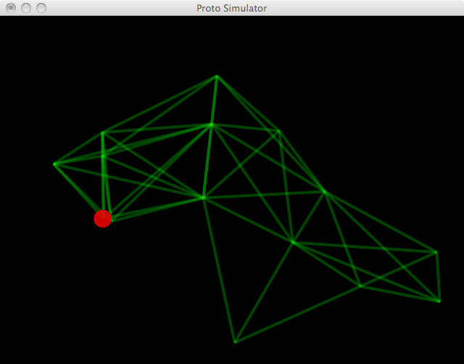
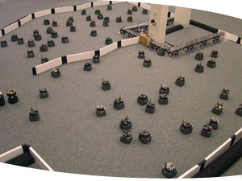
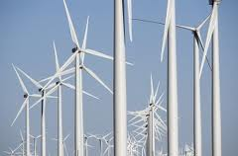
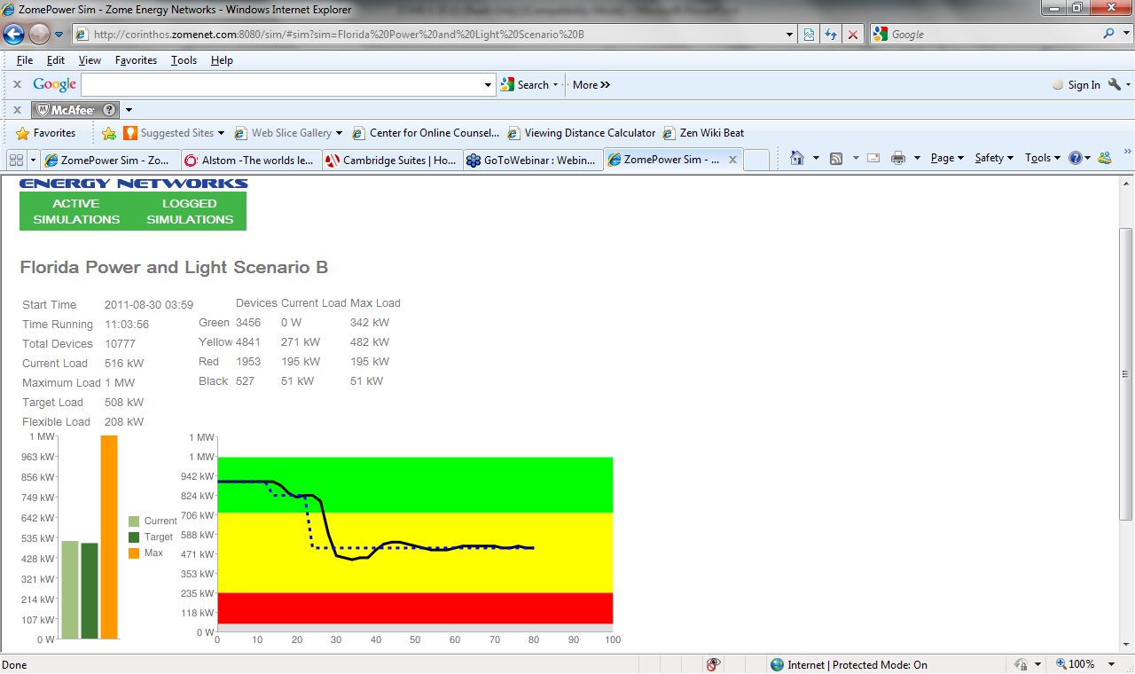
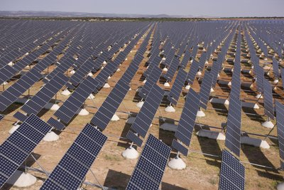
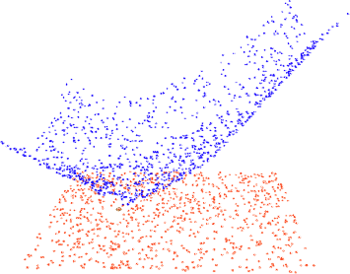
Aggregate Programming: The Big Picture
device
neighborhood
Field-Based
Computing Models
Self-Organization
Building Blocks
Lots of distributed applications!

Slide 3
Our Promises to You
By the end of this tutorial you will…
know about aggregate programming, field calculus, and continuous space-time abstractions
be able to write programs in Proto
understand how field computation can support predictable engineering of complex adaptive systems
understand how to build complex self-organizing systems by composing building-block algorithms

Slide 4
Schedule:
14:00 – 14:30 Aggregate Programming & Spatial Computing Jake
14:30 – 15:30 Field Calculus Mirko
Coffee Break
16:00 – 16:20 Ensuring Self-stabilisation Mirko
16:20 – 17:20 Building Blocks & Consistency Jake
17:20 – 17:30 Summary and Open Problems Jake

Slide 5
Aggregate Programming and Spatial Computing
Jacob Beal, Mirko Viroli
Tutorial at 8th IEEE SASO
Imperial College London
September 2014

Slide 6
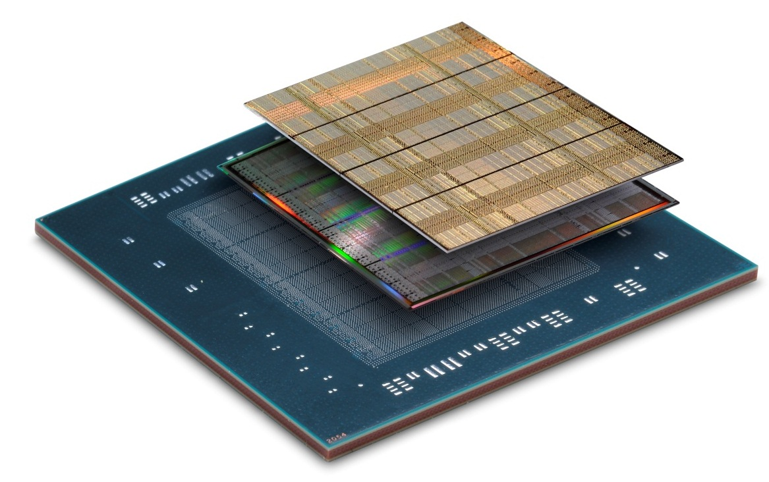
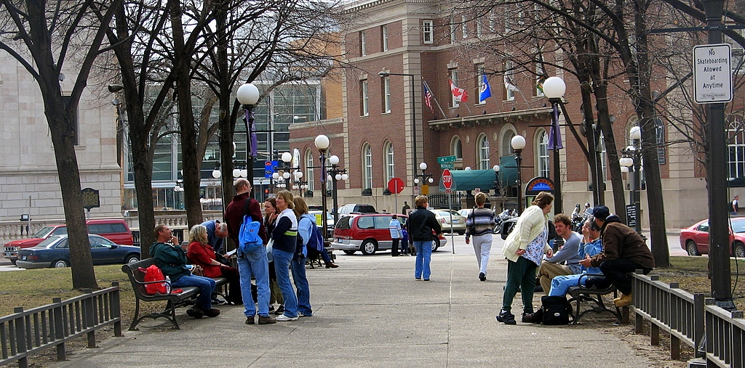
Don’t micromanage your networks!
Emerging Computational Platforms
Computational Field
Programming Models
Inherently Resilient
Distributed Systems
device
neighborhood
Pay a little efficiency, get a lot of programmability and resilience

Slide 7
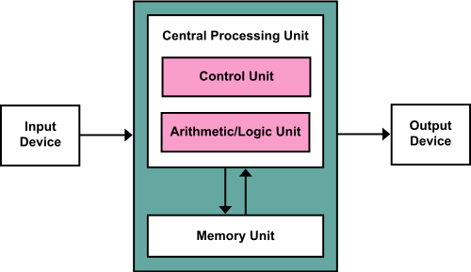
Traditional Monolithic Computing
The venerable von Neumann model is
breaking down in several ways…

Slide 8
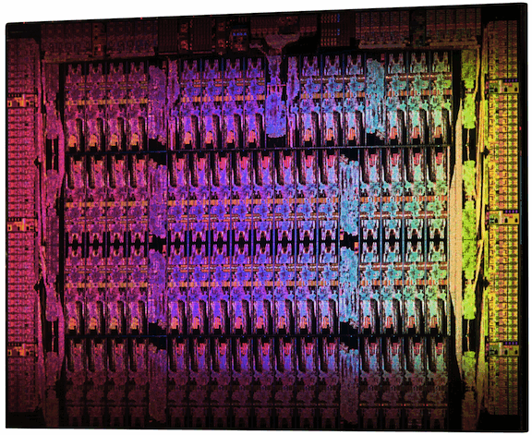
The End of Moore’s Law
Intel Xeon Phi: 61 cores
Xilinx Virtex-7: 2M Logic cells
High-performance computing = mesh

Slide 9
Everything is a wireless computer

Slide 10
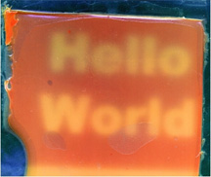
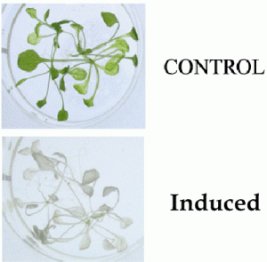
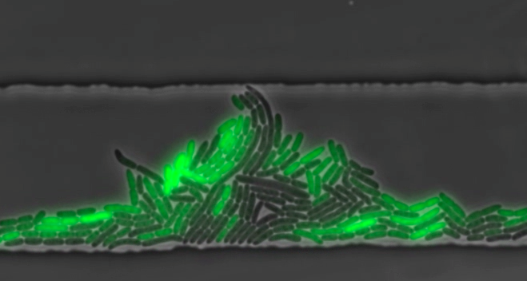
New Computational Materials
Synthetic Biology:
[Levskaya]
[Weiss]
[Medford]
[Hasty]
Other emerging areas too, including nanoassembly, active materials…

Slide 11

Fundamentally different models
Isolate Systems
Extremely High FLOPs
High Dispersion
Moderate FLOPs
High Resolution Sense/Act
Abysmal FLOPs
How can we program aggregates adaptively & efficiently?
Are there commonalities that cross substrates?
Notes:
(e.g., biosensors talk bootstrap off cheap wireless talks to talk to cloud computation

Slide 12
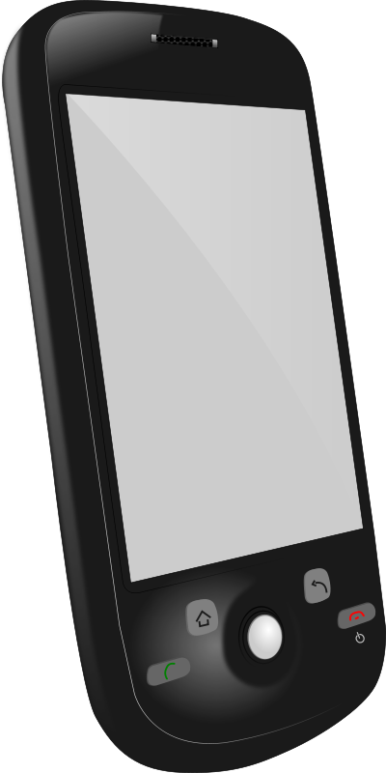
Device-Centric Programming
Dispersal Advice
Congestion-Aware Navigation
Dangerous Density Warning
Crowd Estimation
Explicit design of adaptation and communication
Complex per-device multi-service application
Intractable to ensure correct behavior

Slide 13
Aggregate Programming
Dispersal Advice
Congestion-Aware Navigation
Dangerous Density Warning
Crowd Estimation
Implicit adaptation and communication
Code each collective service independently
Compose via scope and information flow

Slide 14
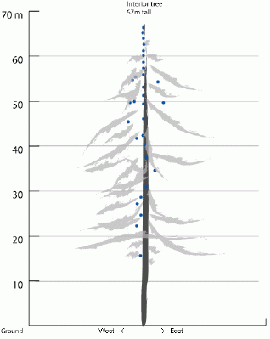
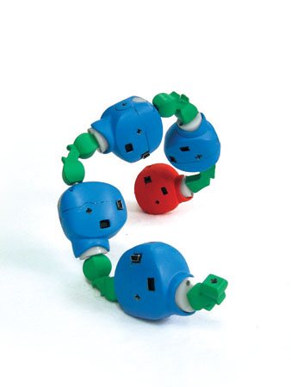
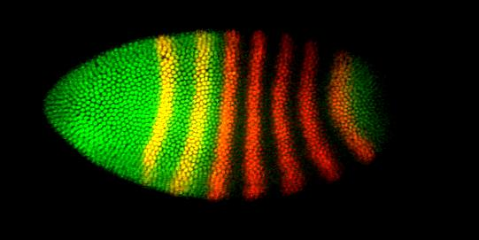
Spatial Computers
Biological Computing
Sensor Networks
Robot Swarms
Modular Robotics
Cells during Morphogenesis
Reconfigurable Computing

Slide 15
More formally...
A spatial computer is a collection of computational devices distributed through a physical space in which:
the difficulty of moving information between any two devices is strongly dependent on the distance between them, and
the “functional goals” of the system are generally defined in terms of the system's spatial structure

Slide 16
More formally...
A spatial computer is a collection of computational devices distributed through a physical space in which:
the difficulty of moving information between any two devices is strongly dependent on the distance between them, and
the “functional goals” of the system are generally defined in terms of the system's spatial structure
Notice the ambiguities in the definition

Slide 17
Graphs
spatial computing
space complexity
density
jitter
grain size
Amorphous/
Continuous
Crystalline
(e.g. CAs)
(w. Dan Yamins)

Slide 18
Example: Services for Mass Events

Slide 19
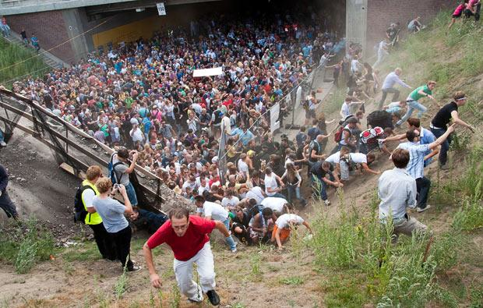
Example: Managing Crowd Danger
Notes:
Love Parade disaster: electronic music festival in Duisberg, Germany in 2010. Many more people came then expected (possibly as many as 1.4 million to an old freight stations holding a max of 250K), and a mass panic caused 21 deaths and 510 injuries.

Slide 20
Example: Agent-Based Simulations
[Beal et al., 2012]

Slide 21
Example: Cellular Oscillator
[Danino et al., 2010]

Slide 22
How can we program these?
Desiderata for approaches:
Simple, easy to understand code
Robust to errors, adapt to changing environment
Scalable to potentially vast numbers of devices
Take advantage of spatial nature of problems

Slide 23

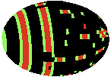
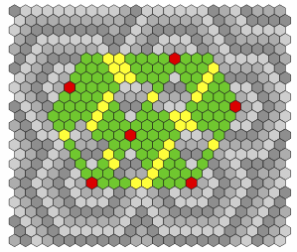

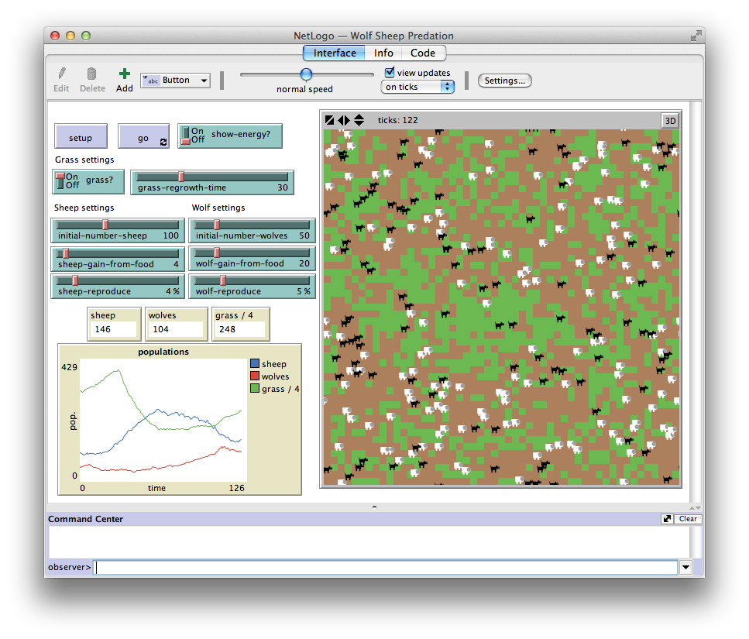
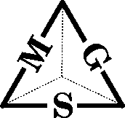
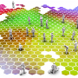
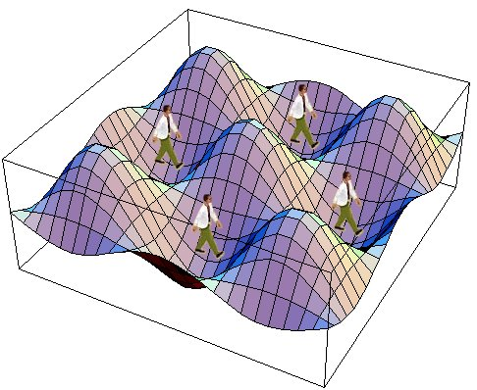


Myriad proposed approaches
A small sample…
OpenMPI
Many Domains: Sensor Networks, Agent systems, Biological Modeling, Synthetic Biology, Pervasive Computing, Amorphous, Swarm/Modular Robotics, High-Peformance Computing, Reconfigurable Computing, …
How do we understand and synthesize them all?
[Beal et al., ’12]

Slide 24
Space/Network Type #1: Sampling
device
neighborhood
e.g. sensor nets, pervasive systems, swarm robots

Slide 25
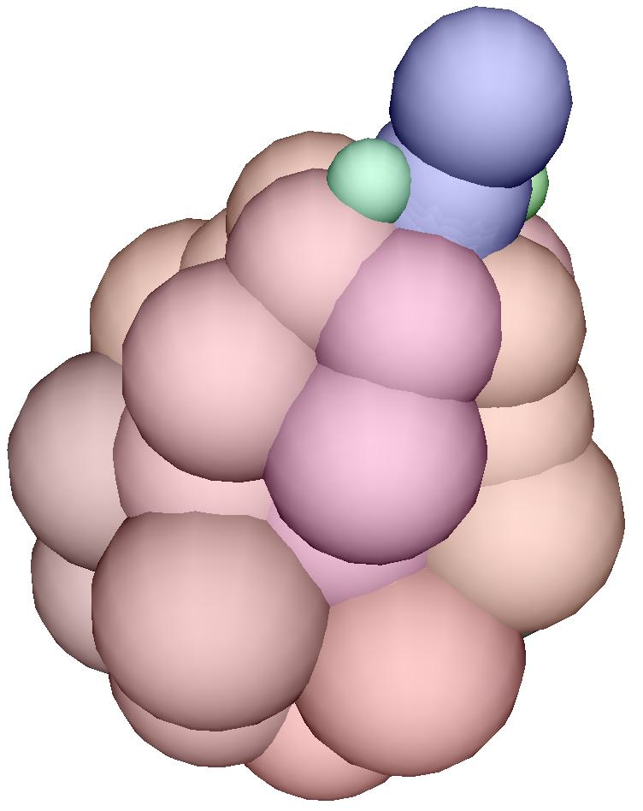
Space/Network Type #2: Cellular
Crystalline
Amorphous
e.g. processing fabrics, biologicals, modular robots

Slide 26
Four General Language Classes
General Purpose
Aggregate Language
Proto, MGS, Protelis
Information Movement Language
TinyDB, WaveScript
Pattern Language
OSL, GPL
Device Abstraction Language
Hood, TOTA, NetLogo, MPI
[Beal et al., ’12]

Slide 27
Field Calculus:
Pointwise
Restriction: if
+
restrict
Feedback: rep
Neighborhood: nbr
41
7
delay
+
nbr
any-hood
48
[Viroli et al., ’13]

Slide 28
Implementation: Proto
(def gradient (src) ...)
(def distance (src dst) ...)
(def dilate (src n)
(<= (gradient src) n))
(def channel (src dst width)
(let* ((d (distance src dst))
(trail (<= (+ (gradient src)
(gradient dst))
d)))
(dilate trail width)))
evaluation
global to local
compilation
Global Local Discrete
platform
specificity &
optimization
device
neighborhood
discrete
approximation
Device
Kernel
[Beal & Bachrach, '06]

Slide 29
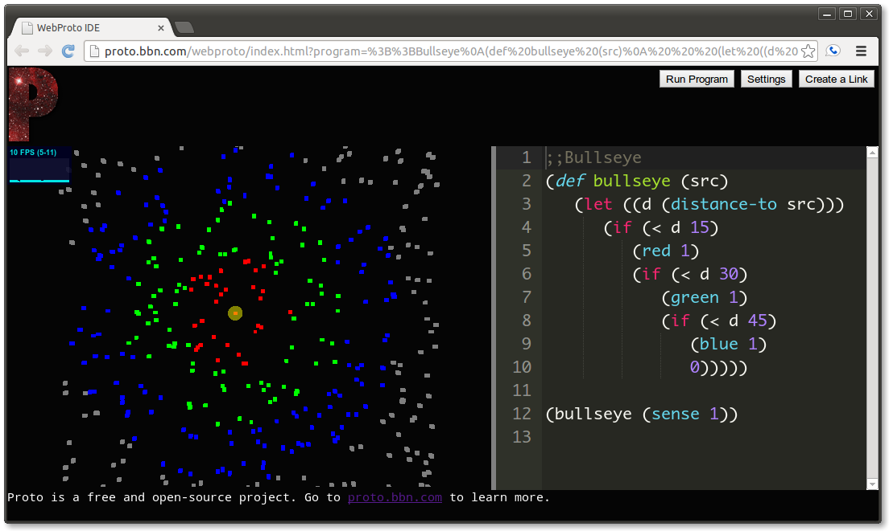
Proto available online!
http://proto.bbn.com/
Free & Open Software
WebProto

Slide 30
From Principle to Practice:
Transparent use of
robust distributed algorithms
Applications
unlimited uses
Programmer level: lots of
useful, intuitive methods
Domain-specific APIs
Distributed Library APIs
many algorithms
Provable robustness,
scalability, composability
Building blocks
5-20 combinators
Provable universality,
aggregate/local relation
Core Calculus
5 operators

Slide 31
Summary
Major technological trends are all driving towards a world filled with distributed systems
Aggregate programming aims at rapid and reliable engineering of complex distributed systems
Field calculus provides a solid mathematical foundation for predicting aggregate behaviors
Aggregates are often closely tied to space, and geometry is a good source of "building blocks"
Methods are useful for many types of application

Slide 32
Bibliography
Beal J, Dulman S, Usbeck K, Viroli M, Correll N. Organizing the Aggregate: Languages for Spatial Computing. In: Mernik M, editor. Formal and Practical Aspects of Domain-Specific Languages: Recent Developments. IGI Global; 2013. p. 436–501.
Viroli M, Damiani F, Beal J. A Calculus of Computational Fields. In: Canal C, Villari M, editors. Advances in Service-Oriented and Cloud Computing. vol. 393 of Communications in Computer and Information Sci. Springer Berlin Heidelberg; 2013. p. 114–128.
Beal J, Bachrach J. Infrastructure for Engineered Emergence in Sensor/Actuator Networks. IEEE Intelligent Systems. 2006 March/April;21:10–19.

